Slide 1
Power bi
Presented by Michael Lo
As used by one Business Analyst

Slide 2
Agenda
Data
Transformation
Visualization
Examples

Slide 3
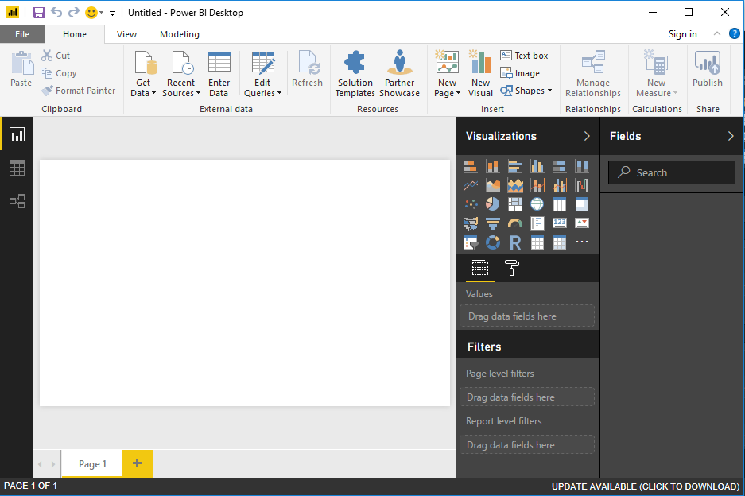
Get Data
Notes:
First step is to bring data or query for data
https://docs.microsoft.com/en-us/power-bi/desktop-data-sources

Slide 4
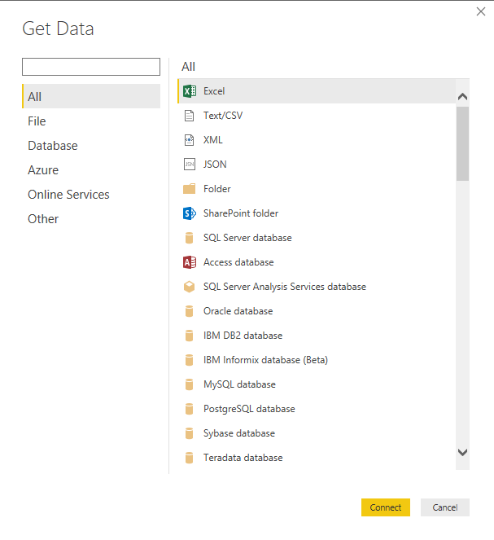
Notes:
Power BI allows for a number of data source
My work with Power BI vision has been with limited data source types and a single data source at a time
e.g. excel, SQL server, SharePoint list

Slide 5
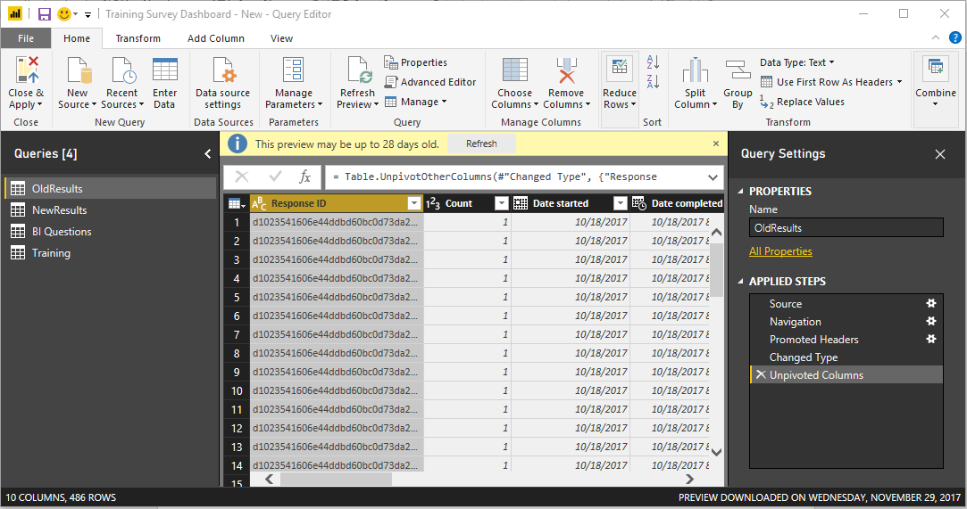
Load
&
Transform
Steps
Notes:
Once Power BI has the data various transformations can be performed in atomic operations
e.g. setting types, unpivoting columns, add columns, edit columns, etc

Slide 6
Notes:
From a single data source you may need to make multiples and model the data in such a way that it can be utilized by the visualization

Slide 7
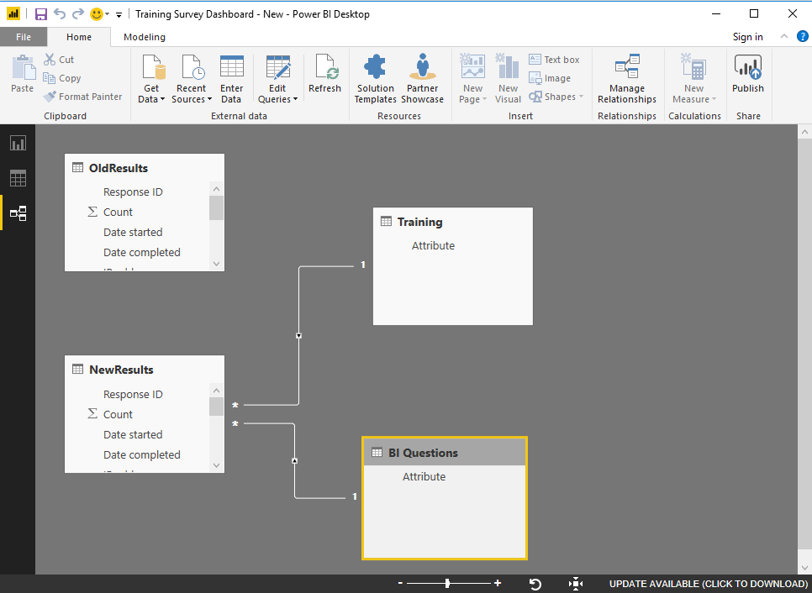
Create Relationships
Notes:
Tables can be added a model in order to leverage visualizations

Slide 8
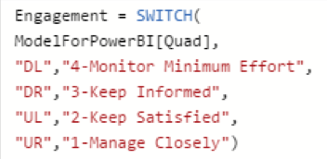
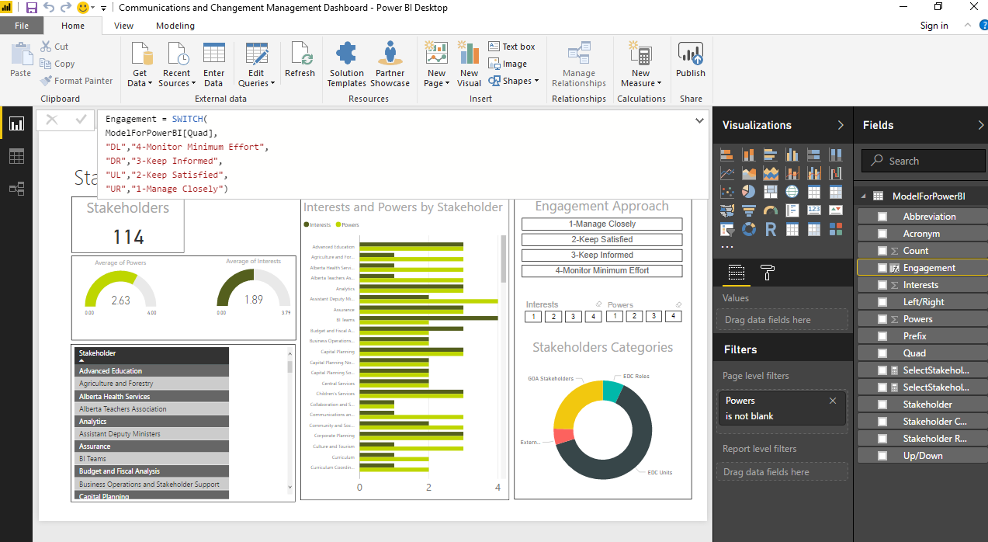
DAX
Notes:
User DAX to create measures
https://docs.microsoft.com/en-us/power-bi/desktop-quickstart-learn-dax-basics

Slide 9
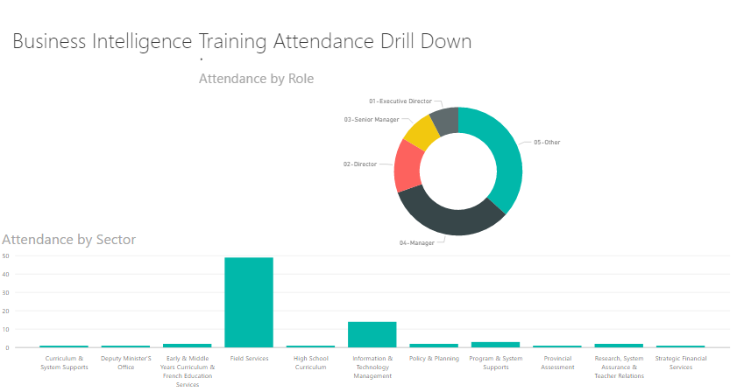
Drilldown

Slide 10
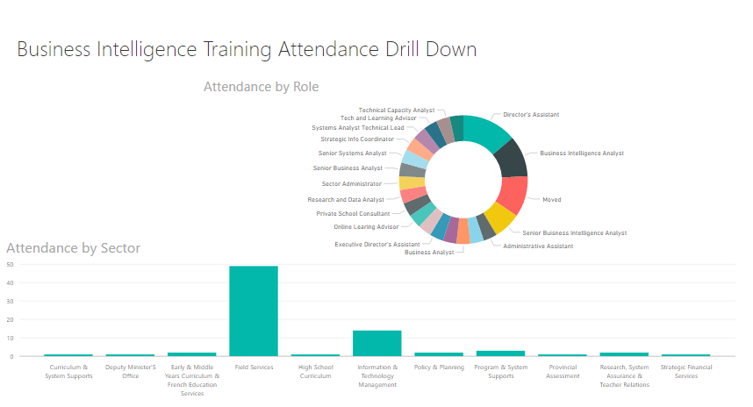

Slide 11
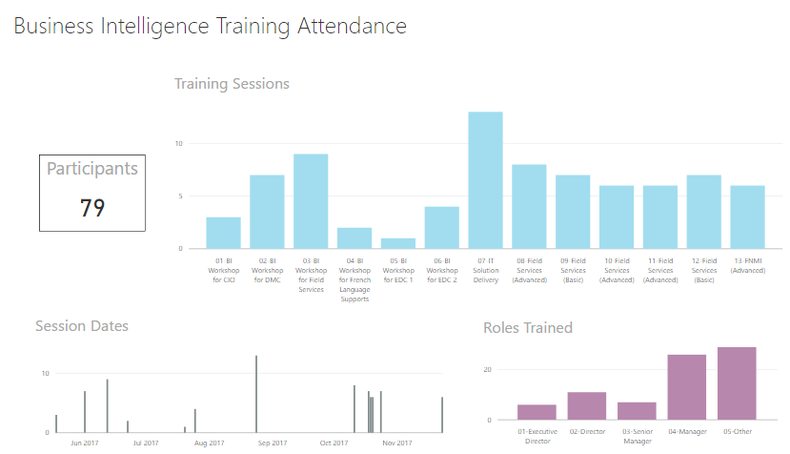
Highlight

Slide 12
